Slide 1

Splitting the Monolith
Jimmy Bogard
@jbogard
github.com/jbogard
jimmybogard.com

Slide 2
Monolith Case Study

Slide 3


Life Insurance and Annuities
40-year old codebase
Aging workforce
Retirement cliff in 5-7 years
Buy didn't work

Slide 4
Monolith: Software whose design, information model, and interface combine multiple competing and interfering domains into one single application and data model.

Slide 5
Microservice: An independently deployable service modeled around a business domain.

Slide 6
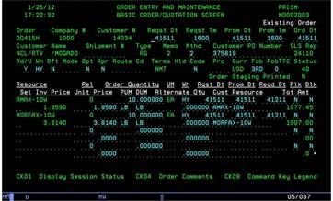
Main Business Challenges
Modernize workforce
Preserve tasks and goals
Improve where possible

Slide 7
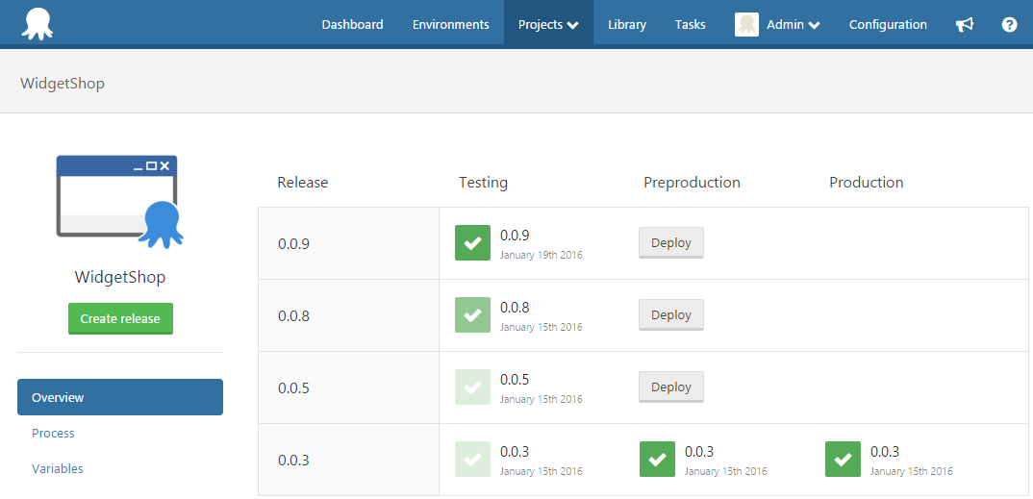
Main IT Challenges
Modernize delivery
Enable agility
Enable DevOps culture

Slide 8
4-Step Strategy

Slide 9

Perspective

Slide 10
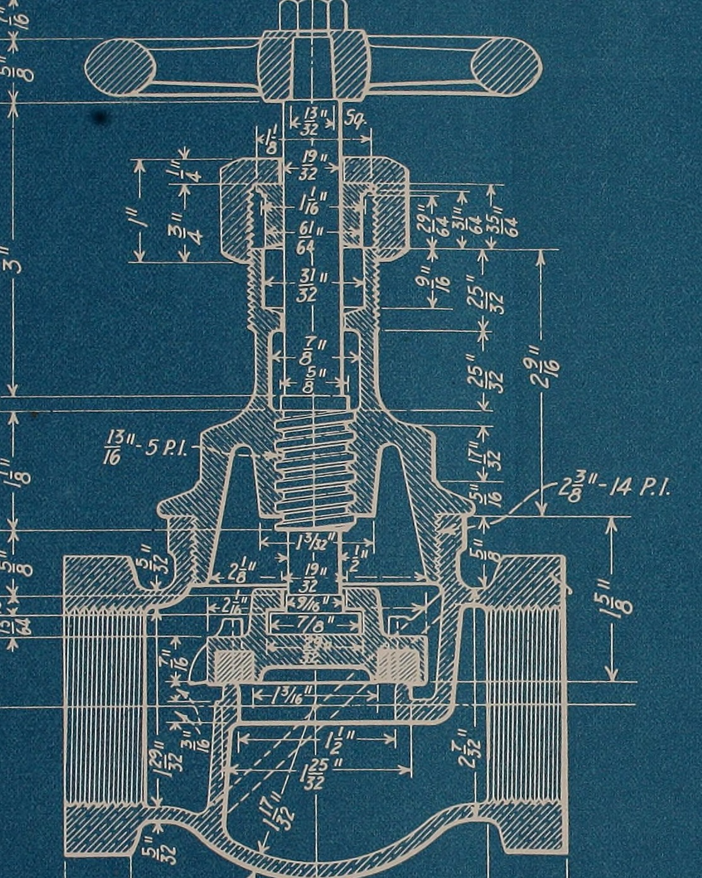
Plan

Slide 11
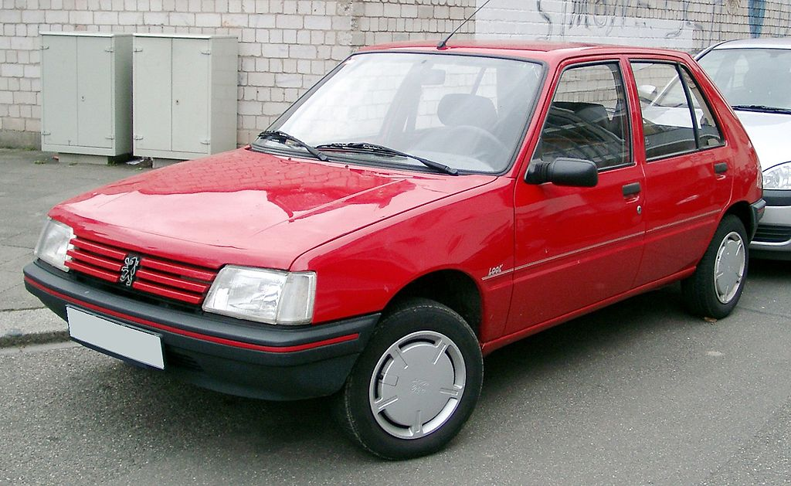
Pilot

Slide 12
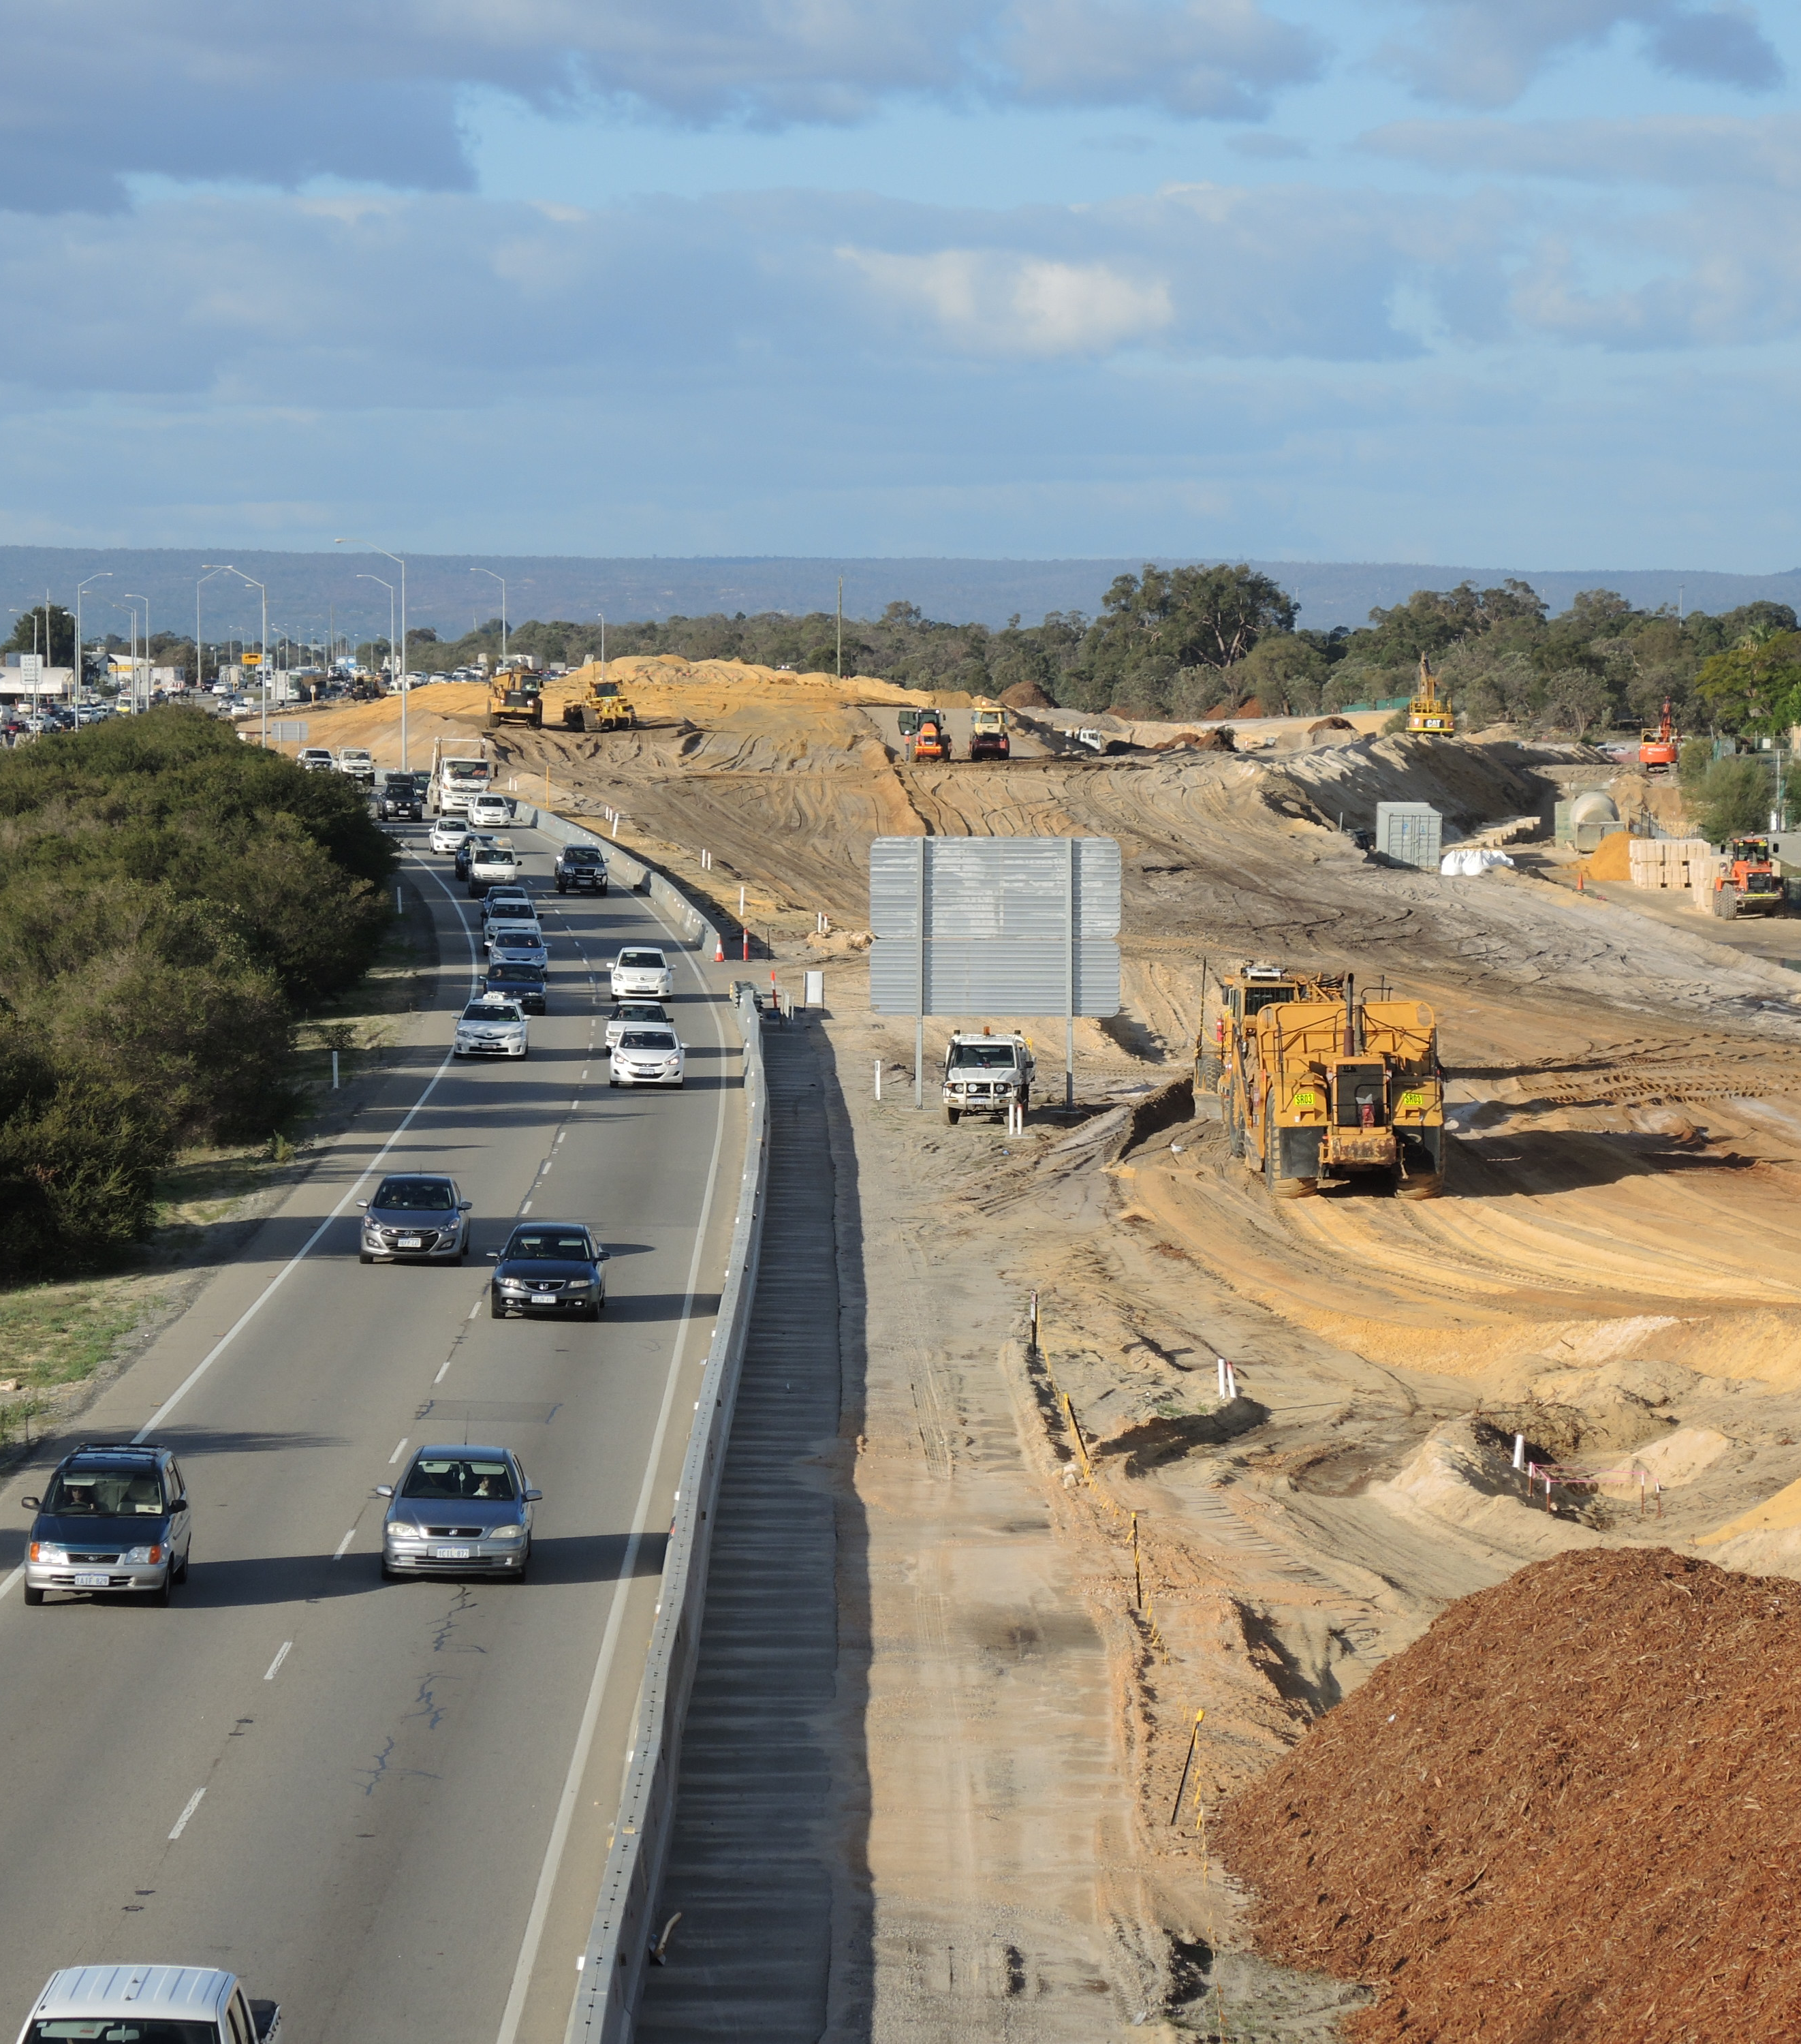
Phased Migration

Slide 13
Perspective

Slide 14

Goals
Understand the What
Understand the Who
Understand the Why
Understand the When
Understand the How
…of everyone affected

Slide 15
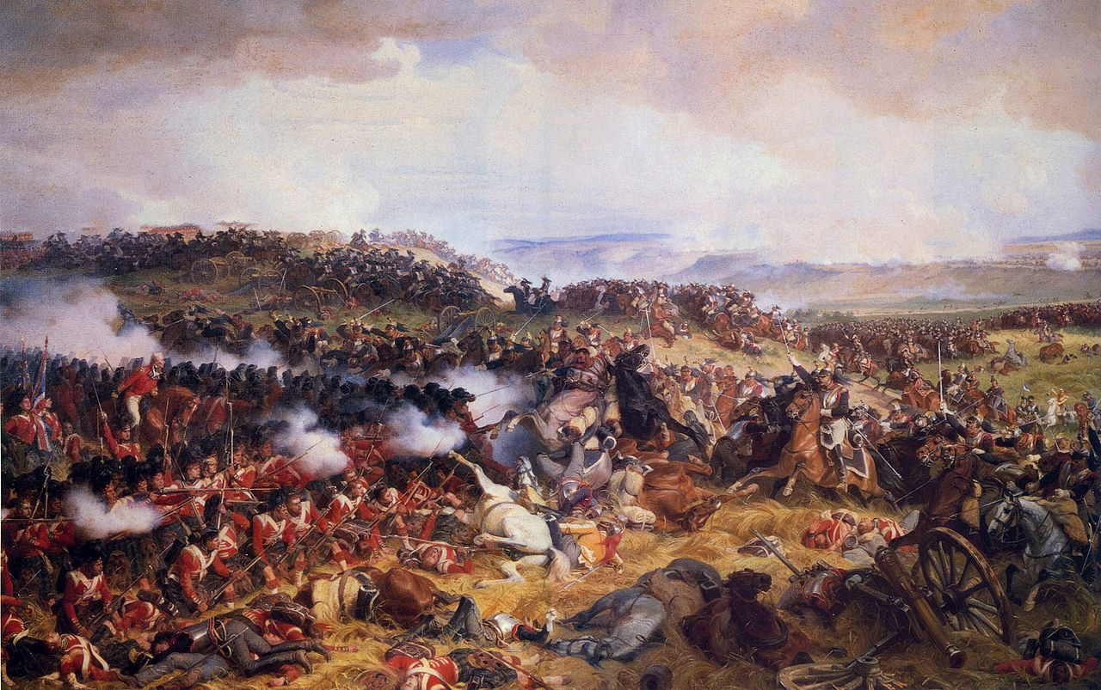
History Lessons

Slide 16

Emotions will run high!

Slide 17
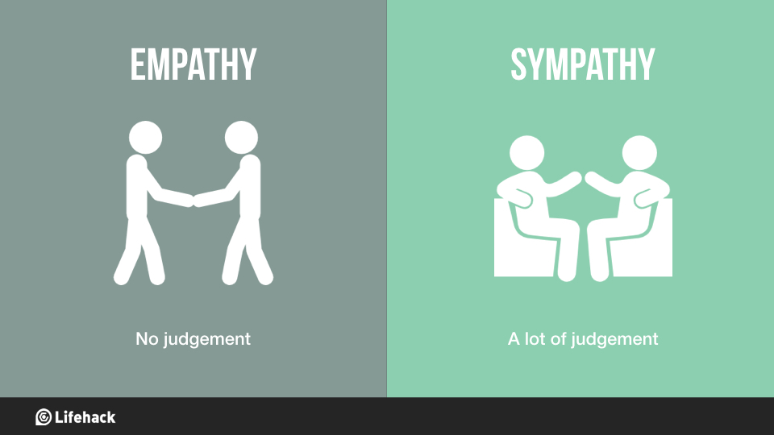

Slide 18
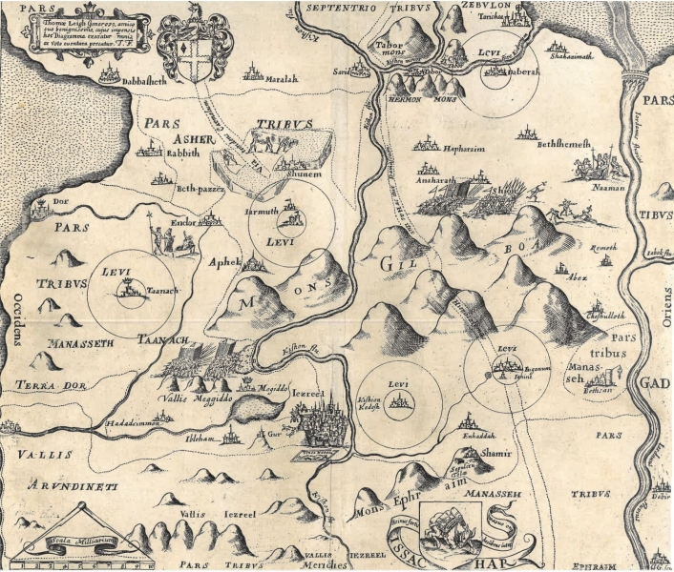
Mapping
People
Process
Information
Technology

Slide 19
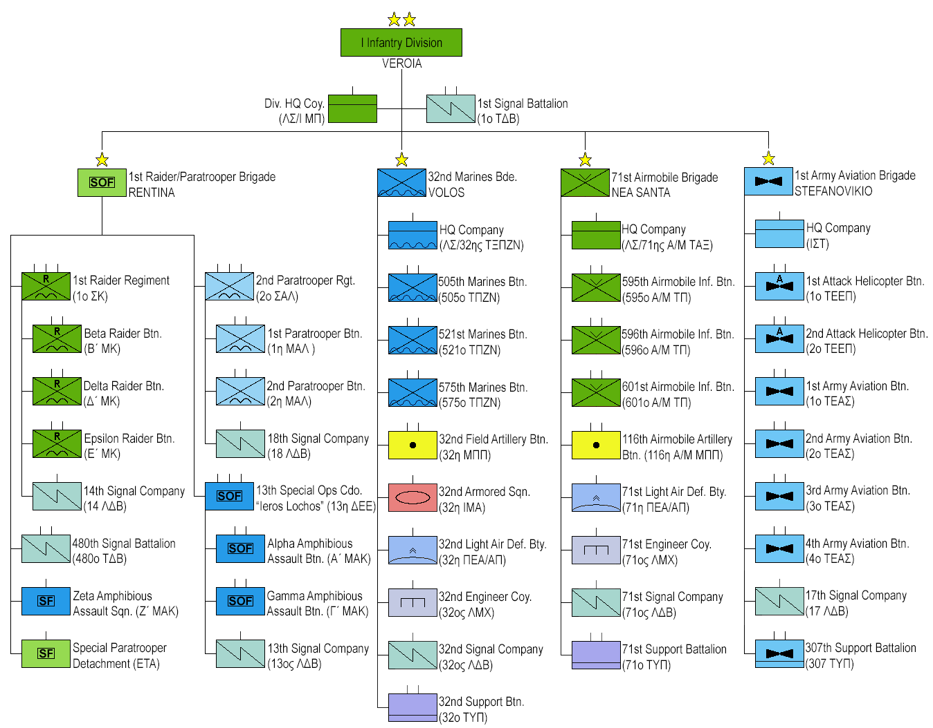
Mapping People

Slide 20

Mapping Processes
Notes:
Inventory
Cycle time (one item)
Change over time (from one finished to the next)
Batch size
Defect rate

Slide 21
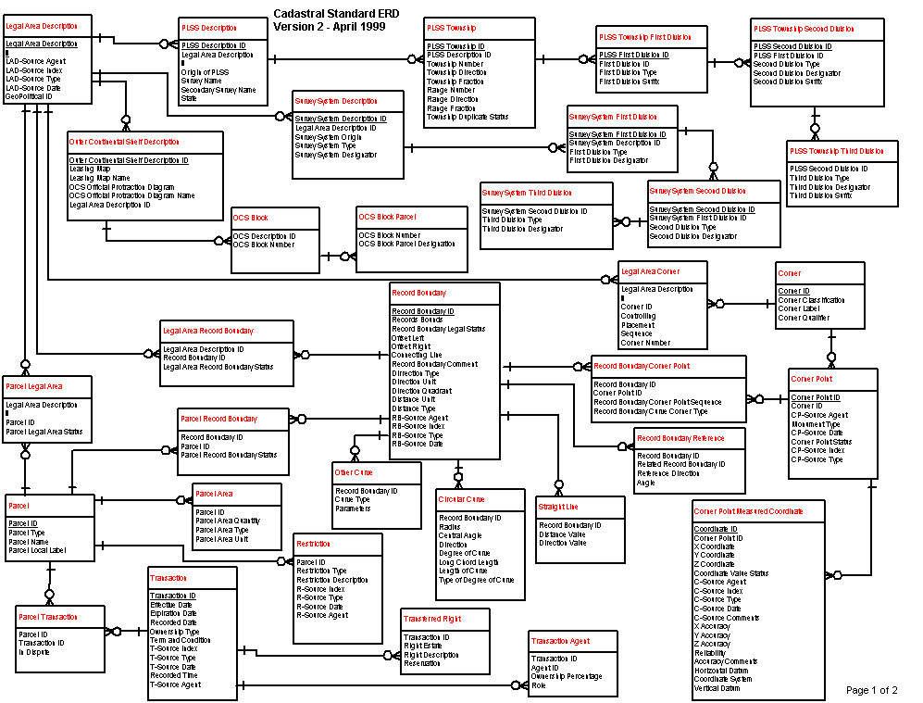

Mapping Information

Slide 22
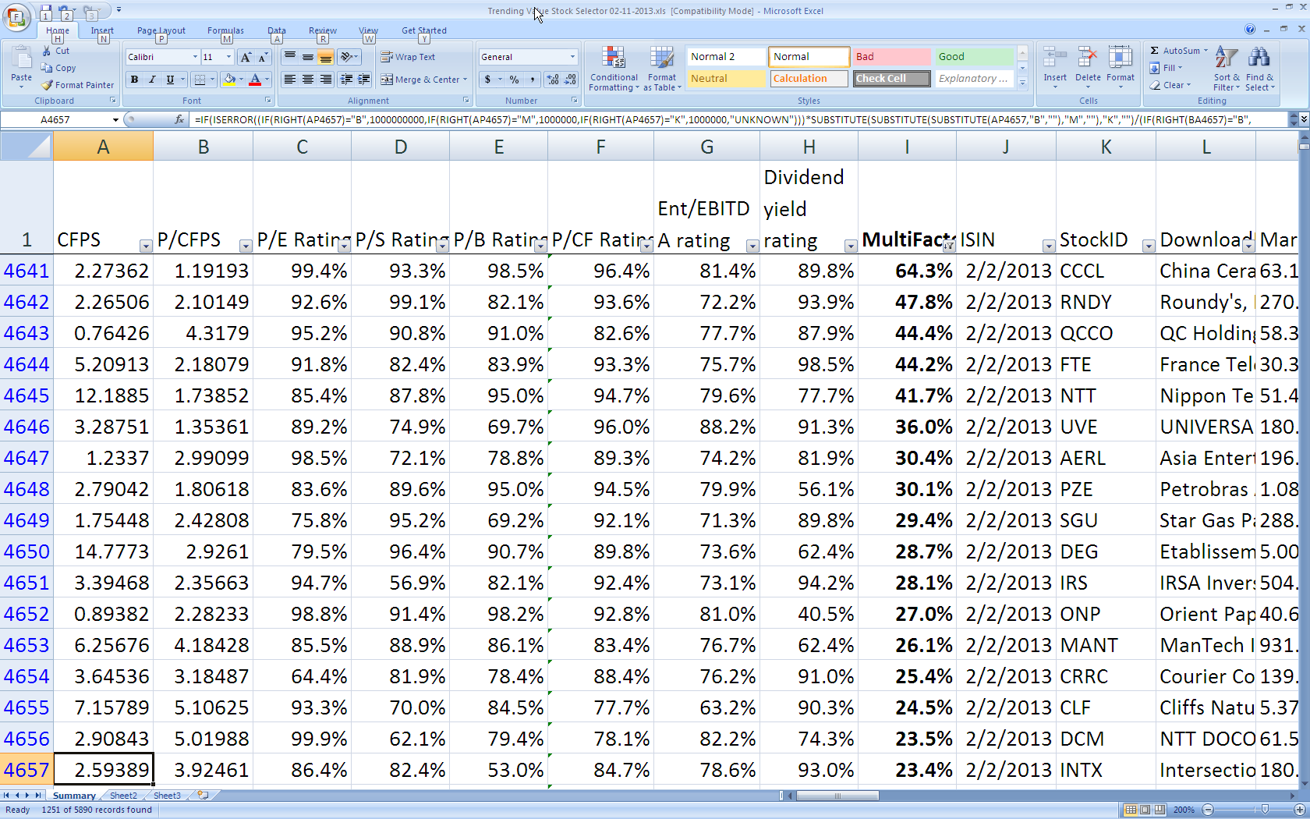
Mapping Technologies

Slide 23
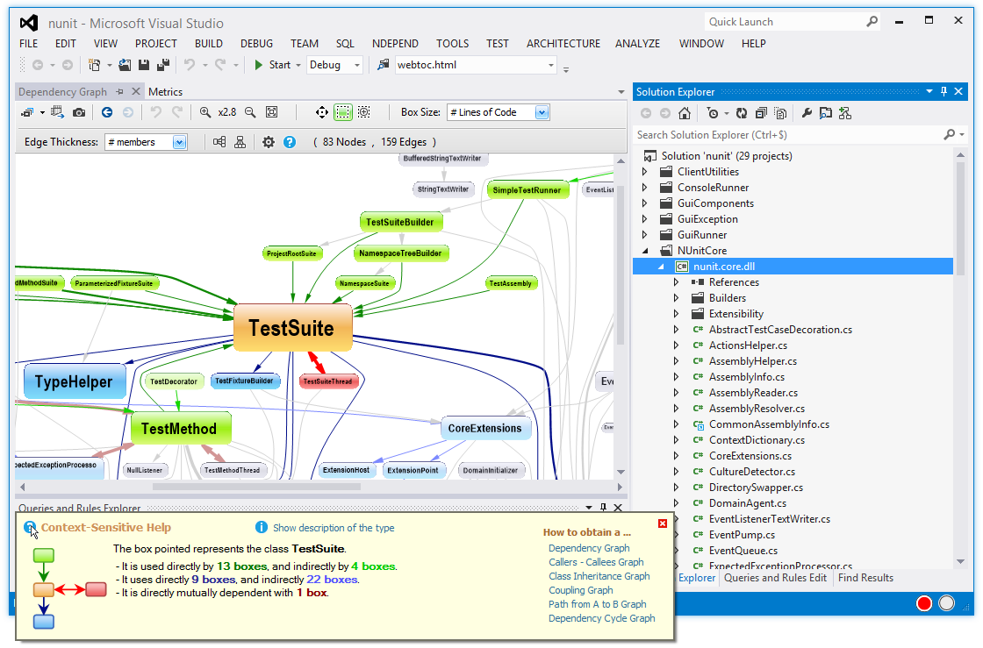
Cataloging Technologies
Applications/systems
Operations possible
Data read/written
Dependencies

Slide 24
Plan

Slide 25
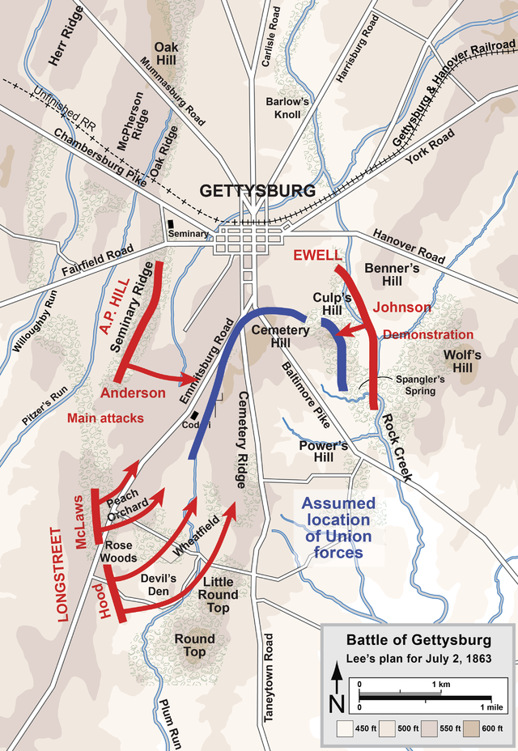
Strategies

Slide 26
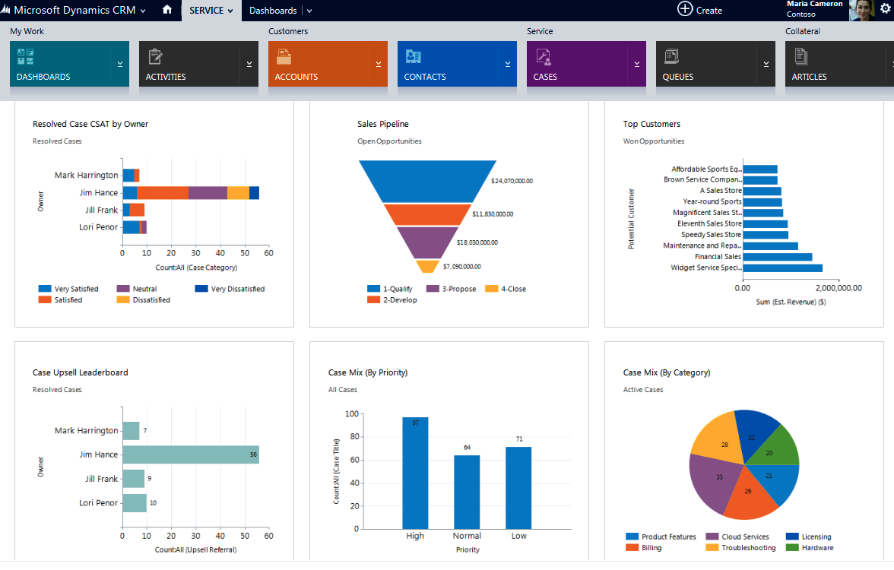
Rewrite

Slide 27
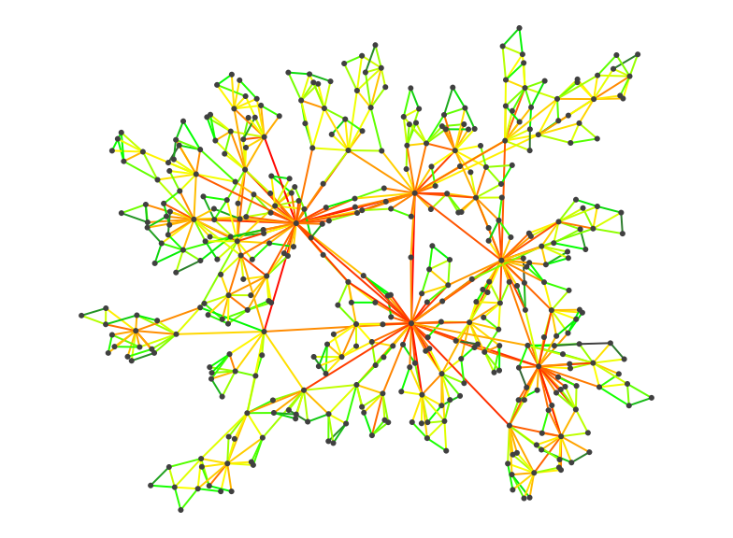
Start at Edges

Slide 28
Sales
Underwriting
Heads or Tails
Admin
Claims
CRM

Slide 29
Underwriting
Accounting
Defining Boundaries
Enterprise Accounts
Claims
Ops

Slide 30
Your boundaries will be wrong! (Plan accordingly)

Slide 31
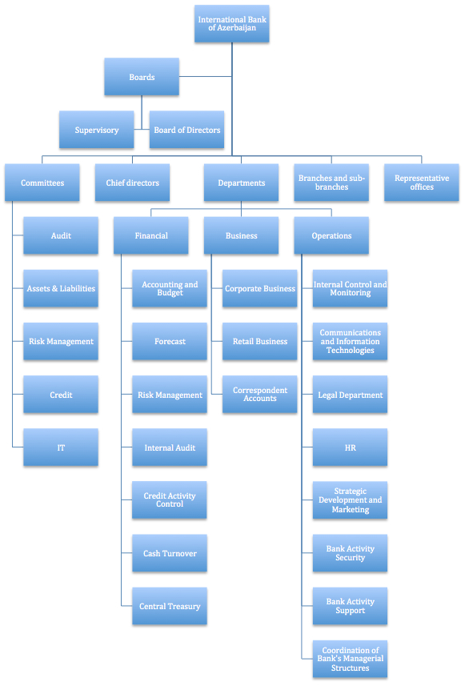
Org Boundary?
(Conway's Law)

Slide 32
Reverse Conway?

Slide 33
Value Chain Alignment

Slide 34
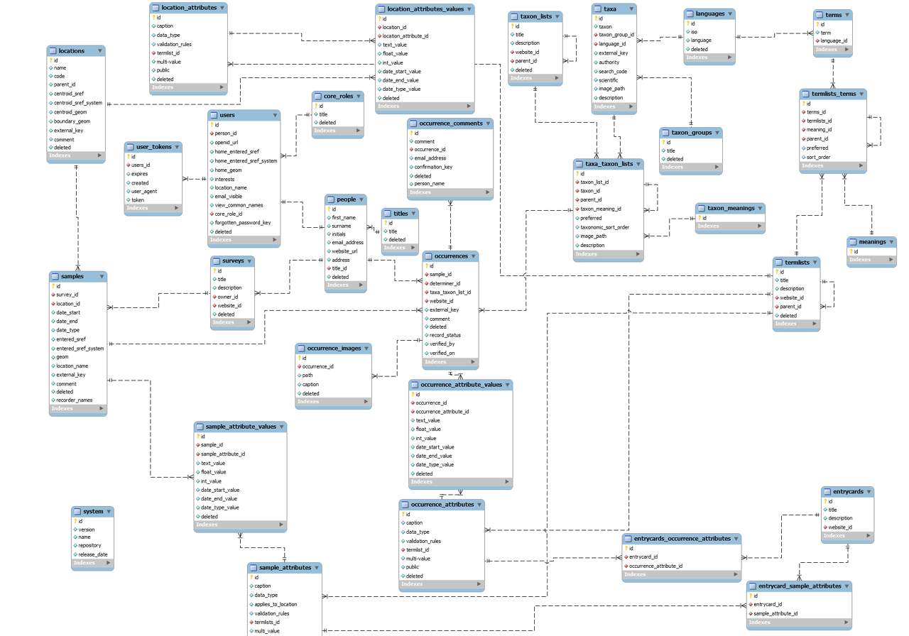
Data Boundaries?
Notes:
Anemic Services

Slide 35
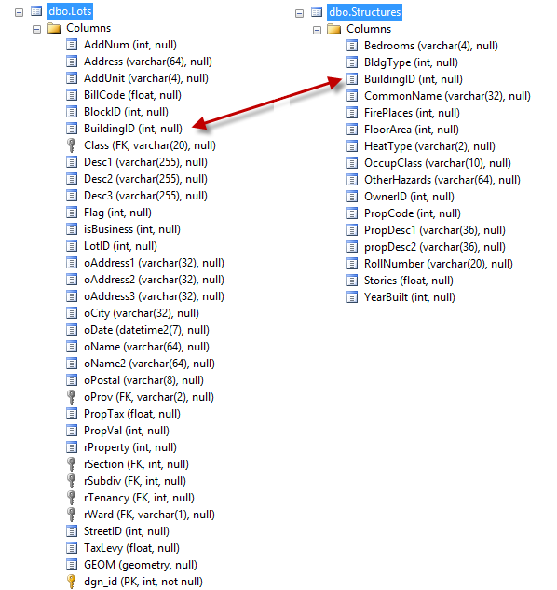
Data Boundary Issues
Notes:
Where to slice? Who reads? Who writes? Which fields? When in the value stream

Slide 36
Small Business
Business or Functional Areas?
Enterprise
Printing and Labels
HR
Customer Service
Notes:
Anemic Services

Slide 37
Rate/Quote/Issuance
Sales Funnel
Value Streams?
Procurement
Onboarding
Notes:
Can cross organizations and lead to composition which is a hard problem

Slide 38

Where to Start?
Notes:
Where to slice? Who reads? Who writes? Which fields? When in the value stream

Slide 39
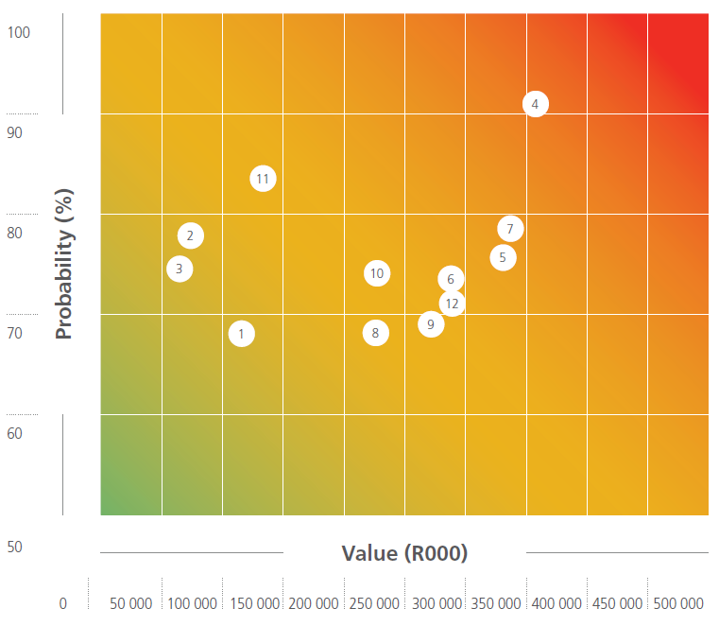
Risk vs. Value
Notes:
Map value vs. risk

Slide 40
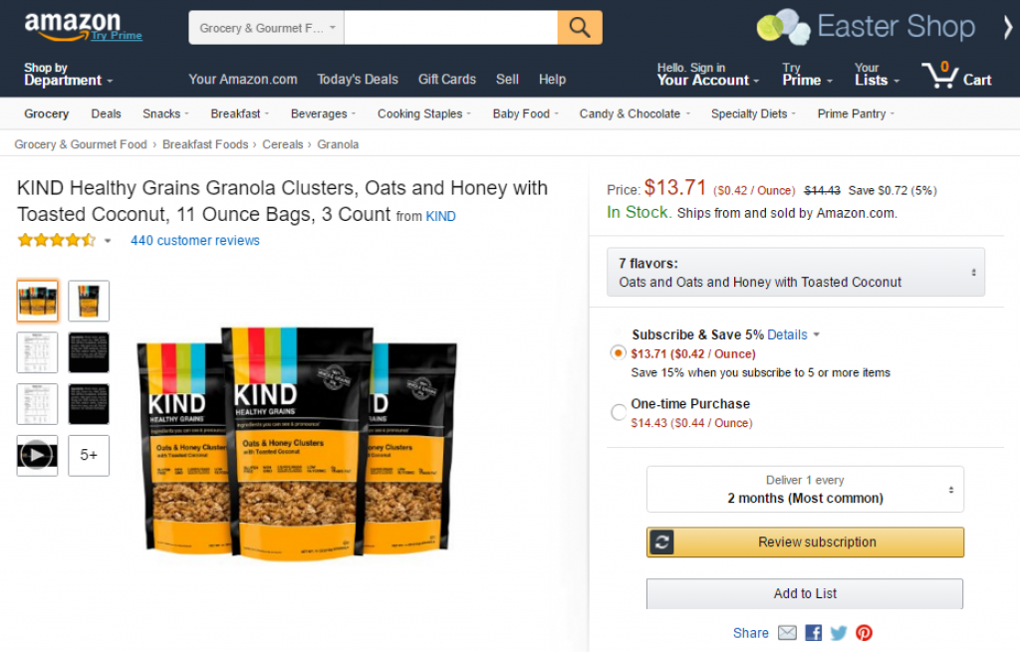
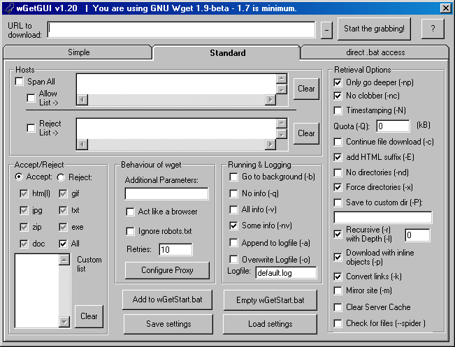
People Risk
Notes:
Where to slice? Who reads? Who writes? Which fields? When in the value stream

Slide 41
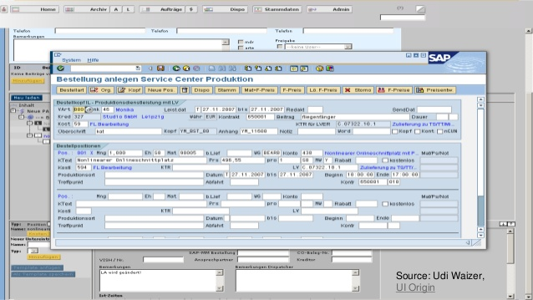
Technology Risk
Notes:
How many connections?
Licensing concerns?
Easy to change?

Slide 42
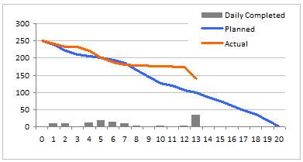
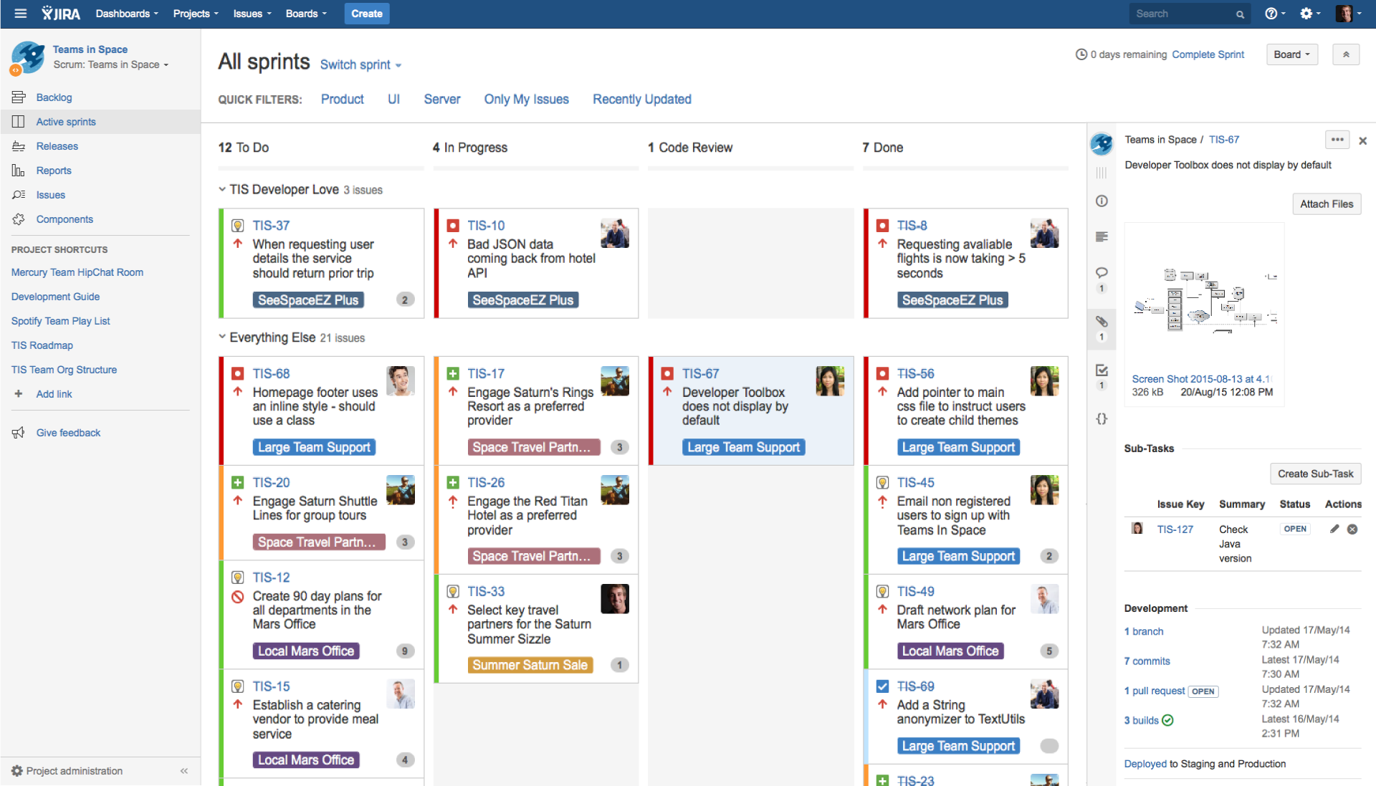
Project and Scope Risk
Notes:
Any looming external deadlines? Are areas going to change? Any areas that are stable?
Is this a group that doesn't really know how they *should* work?

Slide 43
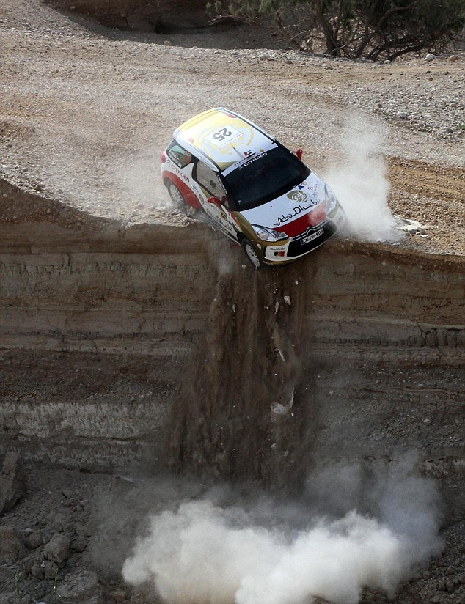
Where *not* to start
Notes:
The middle step of a process
Completely paper-based groups
Contentious areas
Cross-cutting concern services

Slide 44
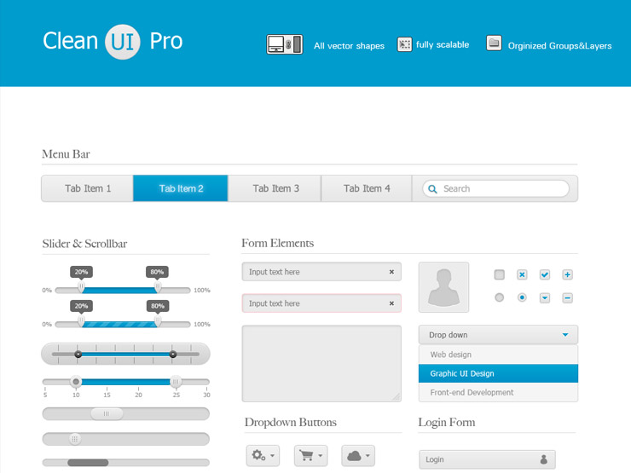
Transitions
Notes:
May be initially more difficult. Some people may use two systems for a bit.

Slide 45
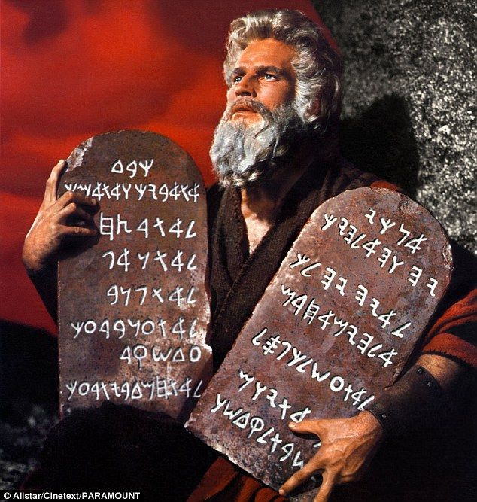
Single source of truth

Slide 46
Migrating Data Paths
Old
New
Monolith
Notes:
Dual-write
Modify read paths
Modify write paths
Remove old data

Slide 47
Avoid bidirectional updates

Slide 48
Disabling Functionality
Notes:
Read-only screens. Removing buttons. Removing permissions. Manual processes harder.

Slide 49
Pilot
Notes:
The simplest solution that still provides the base functionality required to be a complete solution

Slide 50

Dedicated Team

Slide 51
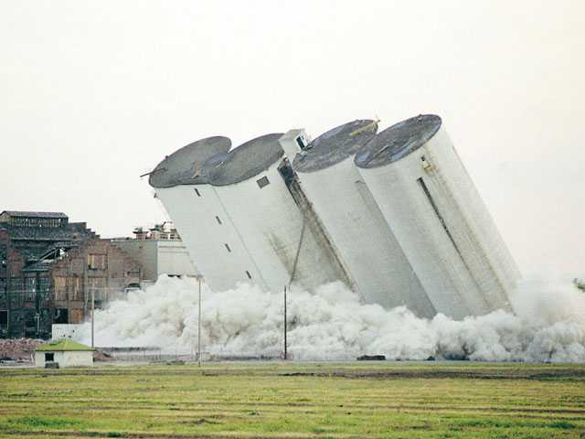
Destroying Silos

Slide 52

What are we building?

Slide 53

Self contained systems?
Notes:
Good for value-stream based divisions

Slide 54
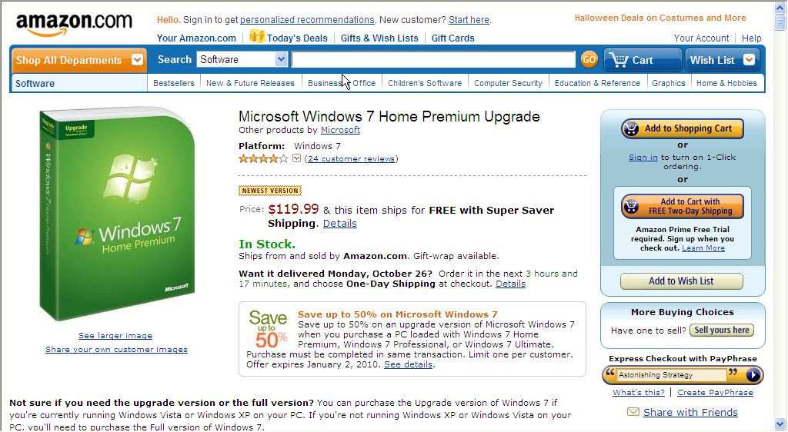
Composite UIs?
Notes:
Better for end-of-process systems

Slide 55

Navel-gazing and bike-shedding
Notes:
Pick the most boring thing

Slide 56

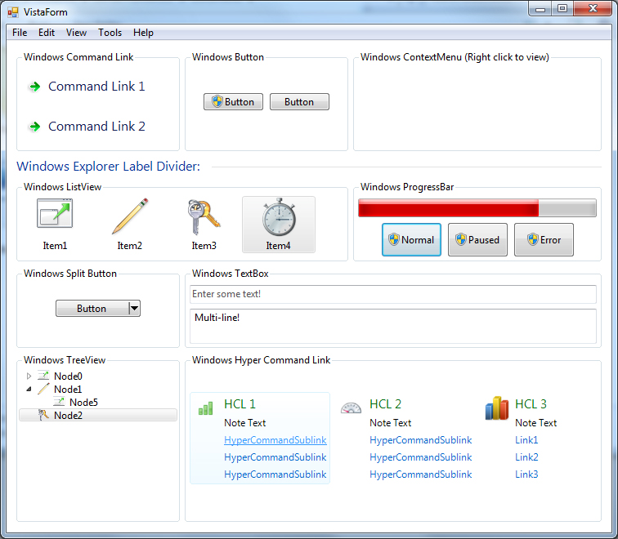
Choosing a Technology

Slide 57
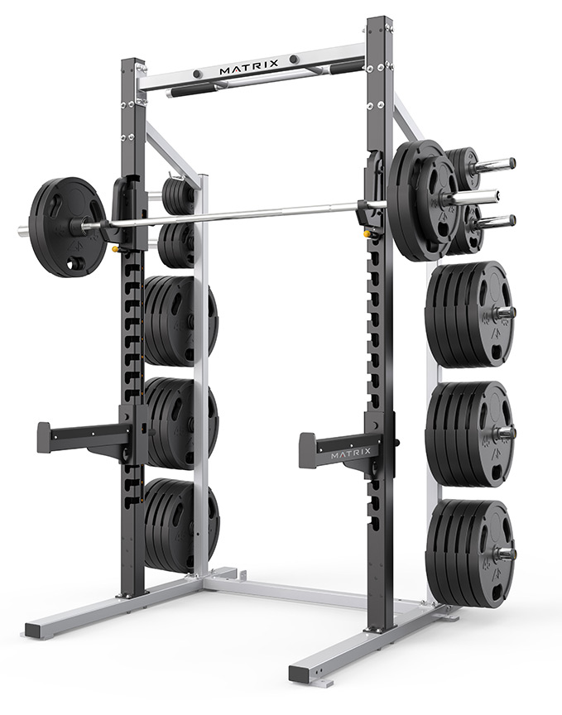
Team Training
Notes:
Have they developed on this platform?
Have they used source control?
Have they done CI?
Have they done CD?
Have they done Agile?
Have they done DevOps?

Slide 58
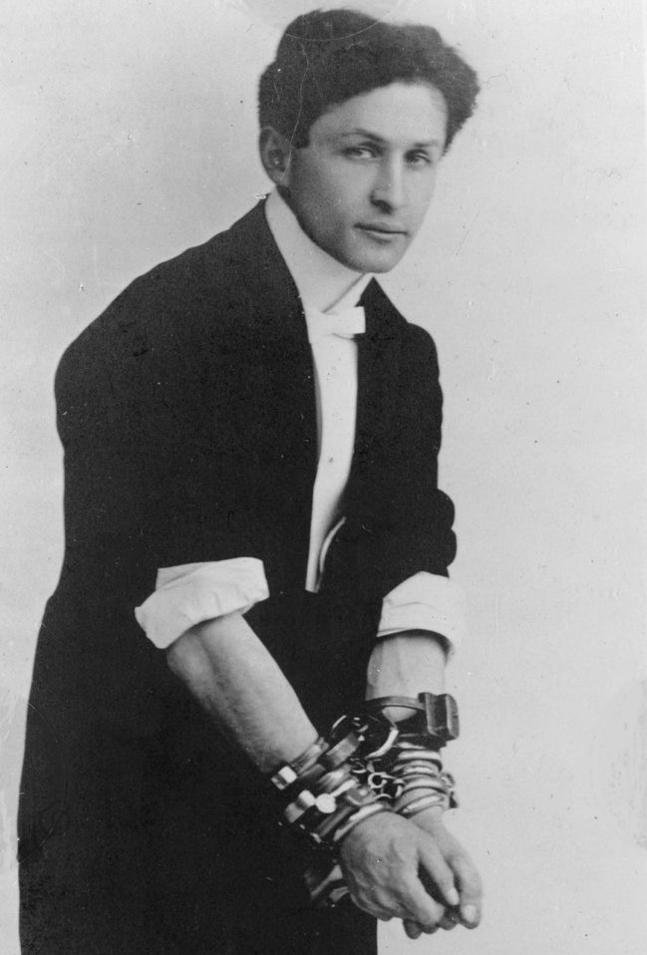
Constraining Scope
Notes:
Do what the old system does
Except its bugs
But maybe those bugs

Slide 59

Constraining Goals
Notes:
Mgmt will want this to be the "new way"
Desire to solve all future "microservice" problems now

Slide 60

Complete Solution
Notes:
If we've done it right, the users are happy, encouraged, and engaged

Slide 61
Phased Migration

Slide 62
Small Business
Enterprise
Next Service?
Printing and Labels
HR
Customer Service
Notes:
Landscape may change as you replace services
Priorities may change from the business
Build vs. buy now in effect

Slide 63
Staging Teams
Time
Planning
Delivery
Planning
Delivery
Planning
Delivery

Slide 64
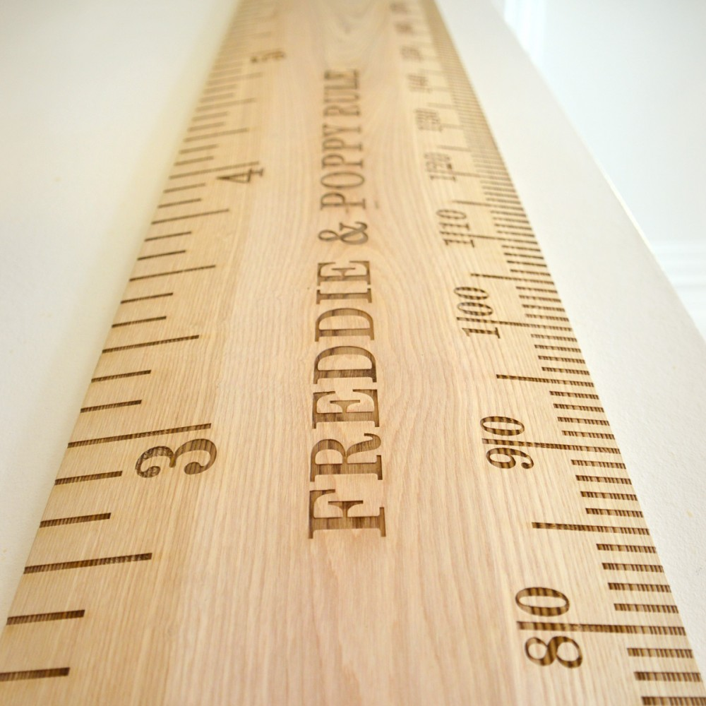
Measuring Progress
Notes:
Retired screens?
Retired tables?
Converted users?
Converted workflows?
Business metrics?

Slide 65
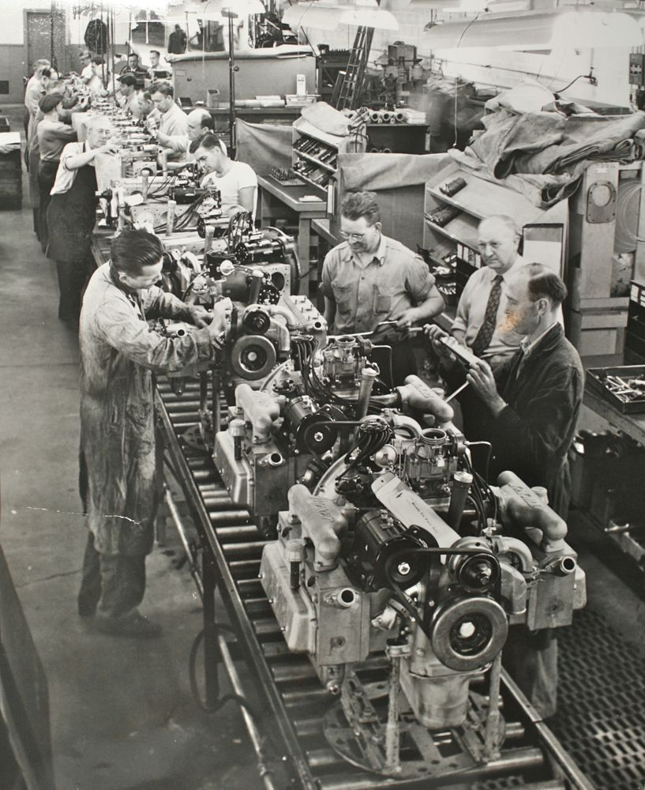

Final Lessons
People over technology
Compassion over disdain
Product over project
No silver bullets

Slide 66

Splitting the Monolith
Jimmy Bogard
@jbogard
jimmybogard.com

